Slide 1

AMEM-Net: Adaptive Multi-Expert Memory Network for Self-Supervised Industrial Visual Anomaly Detection
M.Tech Project Final Review
Presented by
CHIGURUPATI VENKAT SAI KIRAN (25MAI1006)
M.Tech Computer Science and Engineering (AI & ML)
Under the Guidance of
Dr. Reena Roy R
Assistant Professor
School of Computer Science and Engineering
Vellore Institute of Technology, Chennai.

Slide 2
CONTENTS
ABSTRACT
PROBLEM STATEMENT
LITERATURE REVIEW
RESEARCH GAP
PROPOSED SOLUTION
ARCHITECTURE DIAGRAM
DATASET DESCRIPTION
MODULES IDENTIFIED
ALGORITHMS
RESULTS
GUIDE APPROVAL MAIL SCREENSHOT
TIMELINE
REFERENCE

Slide 3
1. ABSTRACT
Industrial visual anomaly detection identifies defective products during manufacturing.
AMEM-Net uses a pretrained WideResNet50-2 model to extract image features.
Four expert memories represent different normal patterns, while an adaptive router selects relevant memories.
Patch-level feature distances are used to calculate anomaly scores and detect defects.
The model was evaluated on 8 selected categories from the MVTec AD dataset.
AMEM-Net was compared with CNN-AE, ResNet-AE, MemAE, and PatchCore.
Results: AUROC-97.72%, Accuracy-93.37%, Precision-96.47%, Recall-93.28%, and F1-score-94.84%.
AMEM-Net achieved the highest macro-average scores across the five reported evaluation metrics among the compared methods.

Slide 4
2. PROBLEM STATEMENT
Industrial products may contain defects such as scratches, cracks, holes, and surface irregularities.
Detecting small and low-contrast defects is challenging because they may look similar to normal product patterns.
Different products have different textures and appearances, making anomaly detection more difficult.
A single shared memory may not represent all types of normal patterns effectively.
Incorrect anomaly thresholds may lead to false alarms or missed defects.
Problem: To develop an anomaly detection method that represents different normal patterns effectively and improves defect detection using expert memories and adaptive routing.
Key Idea:
Normal image → Low reconstruction error → NORMAL
Defective image → High reconstruction error → ANOMALY

Slide 5
3. LITERATURE REVIEW
S.No | Article Title | Techniques Used | Key Findings | Limitations
1 | Towards Total Recall in Industrial Anomaly Detection - PatchCore (Roth et al., 2022) | WideResNet-50, coreset memory bank, nearest neighbour scoring | 99.6% AUROC on MVTec AD | Single flat memory - no specialization per category
2 | SimpleNet: A Simple Network for Image Anomaly Detection (Liu et al., 2023) | Pretrained feature extractor, single feature adapter, Gaussian noise | 99.6% AUROC - fast inference 77 FPS | No memory module - no dynamic routing
3 | Revisiting Reverse Distillation for Anomaly Detection (Tien et al., 2023) | Student-teacher distillation, feature-level comparison | Improved anomaly detection over original reverse distillation | No expert specialization - no memory bank
4 | Visual Anomaly Detection via Partition Memory Bank (Xing et al., 2023) | Partition memory bank, error estimation | Partition memory improves over flat memory | Fixed partitions - no adaptive routing

Slide 6
3. LITERATURE REVIEW
S.No | Article Title | Techniques Used | Key Findings | Limitations
5 | Self-Attention Memory-Augmented Wavelet-CNN (Wu et al., 2022) | Wavelet CNN, self-attention memory module | Self-attention improves memory retrieval | Single memory - no expert specialization
6 | CutPaste: Self-Supervised Learning for Anomaly Detection (Li et al., 2021) | Cut-paste augmentation, self-supervised learning | Strong detection without labeled defect images | No memory module - no routing
7 | Reconstruction-Based Feature Adaptation with Multi-Scale Aggregation (Zuo et al., 2024) | Multi-scale feature aggregation, reconstruction-based detection | Improves detection of small defects | No expert memories - no adaptive routing
8 | MuSc: Zero-Shot Industrial Anomaly Segmentation (Li et al., 2024) | Mutual scoring, zero-shot detection | Strong zero-shot detection without training | No memory - no reconstruction

Slide 7
3. LITERATURE REVIEW
S.No | Article Title | Techniques Used | Key Findings | Limitations
9 | AnomalyGPT: Detecting Anomalies using Vision-Language Models (Gu et al., 2024) | Large vision-language model, few-shot prompting | Natural language-based anomaly detection | No memory module - computationally expensive
10 | Industrial Anomaly Detection via Self-Supervised Feature Enhancement (Fan et al., 2024) | Self-supervised feature enhancement, contrastive learning | Improved self-supervised detection on industrial images | No specialized memory -no dynamic routing
11 | EfficientAD: Accurate Visual Anomaly Detection at Millisecond-Level Latencies (Batzner et al., 2024) | Student-teacher, lightweight autoencoder, feature comparison | Achieves accurate anomaly detection with very low inference latency | Focuses mainly on efficiency; no specialized expert memory
12 | FR-PatchCore: An Industrial Anomaly Detection Method for Improving Generalization (Jiang et al., 2024) | Feature registration, PatchCore, memory bank | Improves PatchCore generalization under spatial transformations | Uses a single memory bank; no dynamic expert routing

Slide 8
3. LITERATURE REVIEW
S.No | Article Title | Techniques Used | Key Findings | Limitations
13 | ReConPatch: Contrastive Patch Representation Learning for Industrial Anomaly Detection (Hyun et al., 2024) | Contrastive patch representation, pretrained features | Learns target-oriented discriminative features and achieves strong MVTec AD performance | No multi-expert memory architecture
14 | Contextual Affinity Distillation for Image Anomaly Detection (Zhang et al., 2024) | Local/global student networks, contextual affinity loss | Captures both local features and long-range dependencies | Uses knowledge distillation rather than adaptive memory
15 | Attention Modules Improve Image-Level Anomaly Detection for Industrial Inspection: A DifferNet Case Study (e Silva et al., 2024) | DifferNet, attention modules | Attention improves industrial image-level anomaly detection | No memory specialization or dynamic routing
16 | A Unified Anomaly Synthesis Strategy with Gradient Ascent for Industrial Anomaly Detection and Localization - GLASS (Chen et al., 2024) | Gradient-ascent anomaly synthesis, feature learning | Strong detection and localization on MVTec AD, VisA and MPDD | Relies on synthetic anomaly generation rather than expert memories

Slide 9
3. LITERATURE REVIEW
S.No | Article Title | Techniques Used | Key Findings | Limitations
17 | Continuous Memory Representation for Anomaly Detection - CRAD (Lee et al., 2024) | Continuous memory, spatial coordinates, continuous grids | Improves memory representation and multi-class generalization | Uses continuous memory, but not multiple specialized expert memories
18 | Hierarchical Gaussian Mixture Normalizing Flow Modeling for Unified Anomaly Detection - HGAD (Yao et al., 2024) | Gaussian mixture modeling, normalizing flow, class centers | Improves unified multi-class anomaly detection by modeling different class distributions | Distribution-based approach; no expert memory routing
19 | GLAD: Towards Better Reconstruction with Global and Local Adaptive Diffusion Models for Unsupervised Anomaly Detection (Yao et al., 2024) | Adaptive diffusion, anomaly synthesis, spatial feature fusion | Improves anomaly-free reconstruction and localization | Diffusion-based architecture; computationally more complex than memory-based AE
20 | A Diffusion-Based Framework for Multi-Class Anomaly Detection - DiAD (He et al., 2024) | Diffusion model, autoencoder, semantic-guided network | Handles multi-class anomaly detection using diffusion-based reconstruction | No specialized memory experts or dynamic routing

Slide 10
3. LITERATURE REVIEW
S.No | Article Title | Techniques Used | Key Findings | Limitations
21 | AnomalyCLIP: Object-Agnostic Prompt Learning for Zero-Shot Anomaly Detection (Zhou et al., 2024) | CLIP, object-agnostic prompt learning | Improves zero-shot anomaly detection across diverse domains | Vision-language approach; no reconstruction memory
22 | PromptAD: Learning Prompts with Only Normal Samples for Few-Shot Anomaly Detection (Li et al., 2024) | Prompt learning, semantic concatenation, anomaly margin | Learns anomaly-aware prompts using only normal samples | Prompt-based; no specialized memory modules
23 | AdaCLIP: Adapting CLIP with Hybrid Learnable Prompts for Zero-Shot Anomaly Detection (Cao et al., 2024) | Static prompts, dynamic prompts, CLIP | Dynamic prompts improve adaptation to different test images | Dynamic prompting rather than memory-based routing
24 | MambaAD: Exploring State Space Models for Multi-Class Unsupervised Anomaly Detection (He et al., 2024) | Mamba, state-space model, multi-scale decoder | Captures local and long-range dependencies with efficient computation | No memory-bank expert specialization

Slide 11
3. LITERATURE REVIEW
S.No | Article Title | Techniques Used | Key Findings | Limitations
25 | Dinomaly: The Less Is More Philosophy in Multi-Class Unsupervised Anomaly Detection (Guo et al., 2025) | DINOv2, Transformer, noisy bottleneck, loose reconstruction | Achieves strong multi-class anomaly detection using a simple reconstruction framework | No adaptive multi-expert memory mechanism
26 | RareCLIP: Rarity-Aware Online Zero-Shot Industrial Anomaly Detection (He et al., 2025) | CLIP, prototype patch memory bank, dynamic rarity estimation | Uses an online memory bank and dynamic rarity estimation for real-time detection | Memory is used for rarity estimation, not specialized visual expert memories
27 | ReMP-AD: Retrieval-Enhanced Multi-Modal Prompt Fusion for Few-Shot Industrial Visual Anomaly Detection (Ma et al., 2025) | Token retrieval, multimodal prompt fusion, memory bank | Retrieval reduces noisy references and improves few-shot anomaly detection | Retrieval/prompt based; no reconstruction-based expert memory
28 | Unseen Visual Anomaly Generation - AnomalyAny (Sun et al., 2025) | Stable Diffusion, attention-guided anomaly optimization, prompt refinement | Generates diverse unseen anomalies from normal samples | Focuses on anomaly generation rather than memory specialization

Slide 12
3. LITERATURE REVIEW
S.No | Article Title | Techniques Used | Key Findings | Limitations
29 | Unsupervised Anomaly Detection with Memory Bank and Contrastive Learning - MemConNet (2025) | Contrastive learning, feature recalibration, memory bank | Improves memory feature quality and achieves strong MVTec/VisA performance | Uses one memory-bank framework rather than multiple adaptive experts
30 | A Multi-Expert Framework for Enhancing Multimodal Large Language Models in Industrial Anomaly Detection - MoXpert (2025) | Gated multi-expert framework, dynamic routing, retrieval | Uses multiple experts and dynamic routing for industrial anomaly detection | Multi-expert design is for MLLM reasoning; not reconstruction-based visual expert memory

Slide 13
4. RESEARCH GAPS
Representation of Diverse Normal Patterns: A single shared memory may not effectively represent the different normal visual patterns found in industrial products.
Adaptive Memory Routing and Score Fusion: The effectiveness of dynamically selecting multiple expert memories and combining their anomaly scores needs further investigation.
Generalization to Unseen Product Categories: The ability to detect defects in new product categories not used during training requires further evaluation.
Contribution of Individual Components: The individual contributions of expert memories, adaptive routing, and score fusion need to be verified through controlled ablation experiments.

Slide 14
5. PROPOSED SOLUTION
Develop AMEM-Net for self-supervised industrial visual anomaly detection.
Use a pretrained WideResNet50-2 model to extract visual features from industrial images.
Construct four expert memories to represent different normal patterns.
Implement an adaptive routing mechanism to assign weights to the expert memories.
Calculate anomaly scores using cosine distances between image features and stored memory features.
Combine the router-weighted anomaly score (55%) with the minimum-distance score (45%).
Calculate the final image anomaly score using the top 5% of patch scores.
Classify images as normal or anomalous using a selected anomaly threshold.
Evaluate the model on eight selected MVTec AD categories and compare its performance with existing methods.

Slide 15
6. ARCHITECTURE DIAGRAM

Slide 16
7. DATASET DESCRIPTION
Dataset: MVTec Anomaly Detection (MVTec AD)
Property | Details
Published | IEEE CVPR 2019
Total images | 5,354 high resolution images
Training images | 3,629 normal images only
Test images | 1,725 normal + anomaly images
Total categories | 15 categories
Categories used | 8: Bottle, Carpet, Hazelnut, Metal Nut, Wood, Leather, Cable, Transistor
Anomaly types | 70+ defect types
Ground truth | Pixel-level binary masks

Slide 17
8. MODULES IDENTIFIED
Image Preprocessing: Resize and normalize industrial images before processing.
Feature Extraction: Use pretrained WideResNet50-2 to extract multi-scale visual features.
Expert Memory Construction: Create four expert memories to store normal image features.
Adaptive Routing: Assign weights to the expert memories based on input features.
Router Training: Train the router using normal images and synthetic pseudo-anomalies.
Anomaly Score Calculation: Calculate patch-level anomaly scores using cosine distances to stored memory features.
Score Fusion: Combine the routed anomaly score (55%) and minimum-distance score (45%).
Evaluation and Classification: Generate image-level anomaly scores, apply a threshold, and evaluate performance using accuracy, AUROC, precision, recall, and F1-score.

Slide 18
9. ALGORITHMS
WideResNet50-2: Extracts multi-scale features from industrial images using a pretrained, frozen network.
MiniBatch K-Means: Groups normal feature vectors to help assign them to expert memories.
Adaptive Routing MLP: Routes feature vectors across four expert memories using softmax weights.
Cosine Distance: Measures the difference between input features and stored normal feature vectors.
Score Fusion: Combines routed anomaly scores (55%) and minimum-distance scores (45%).
Top 5% Patch Aggregation: Uses the highest-scoring image patches to calculate the final image anomaly score.
Youden’s J Statistic: Selects the classification threshold using validation data.

Slide 19
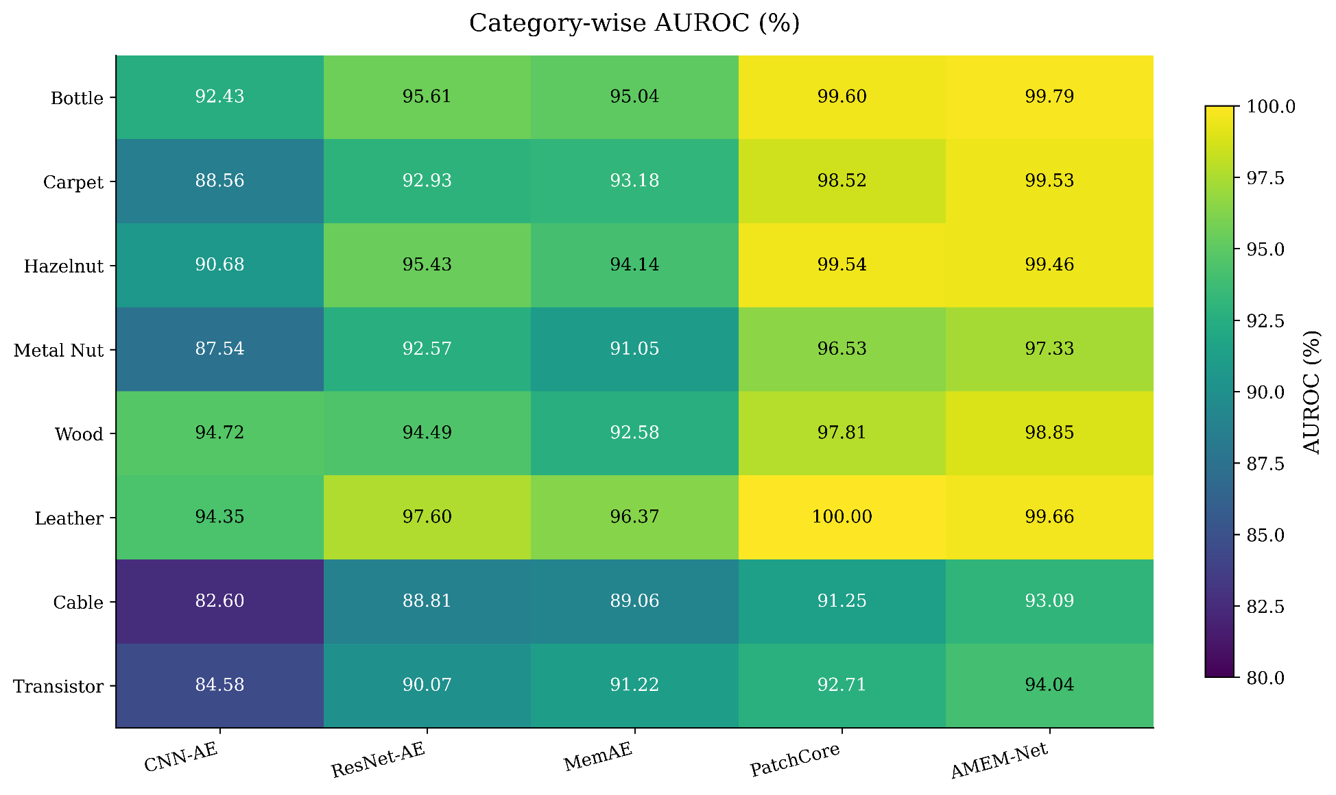
10. RESULTS

Slide 20
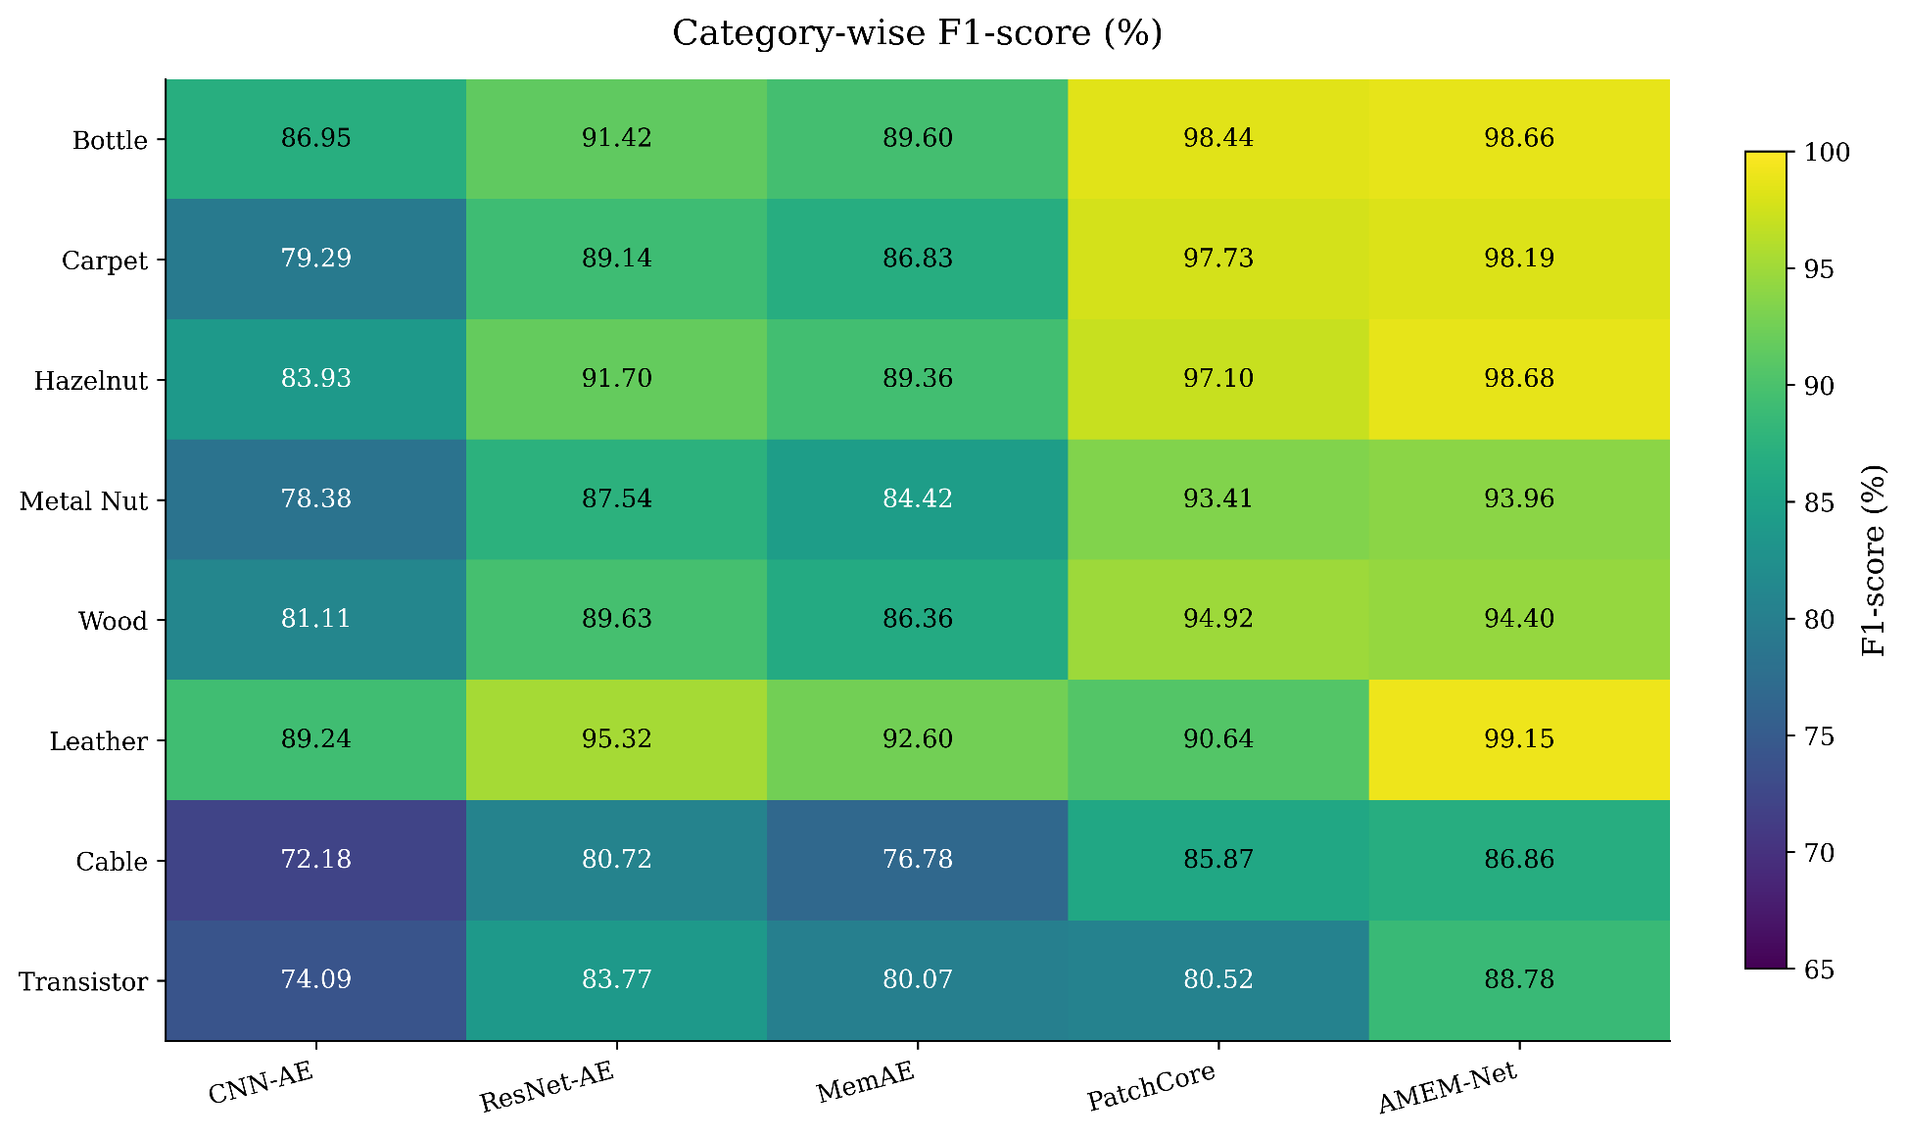
10. RESULTS

Slide 21
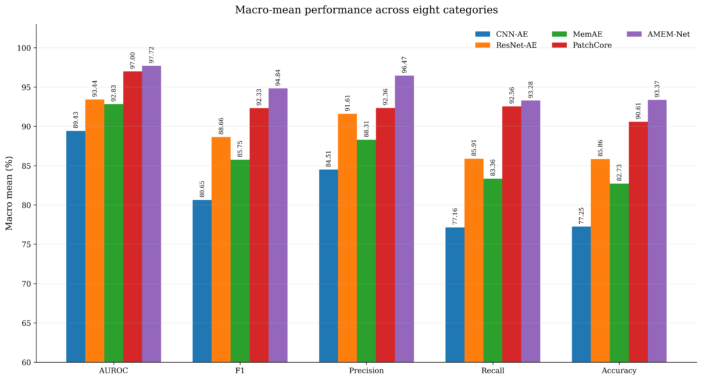
10. RESULTS

Slide 22
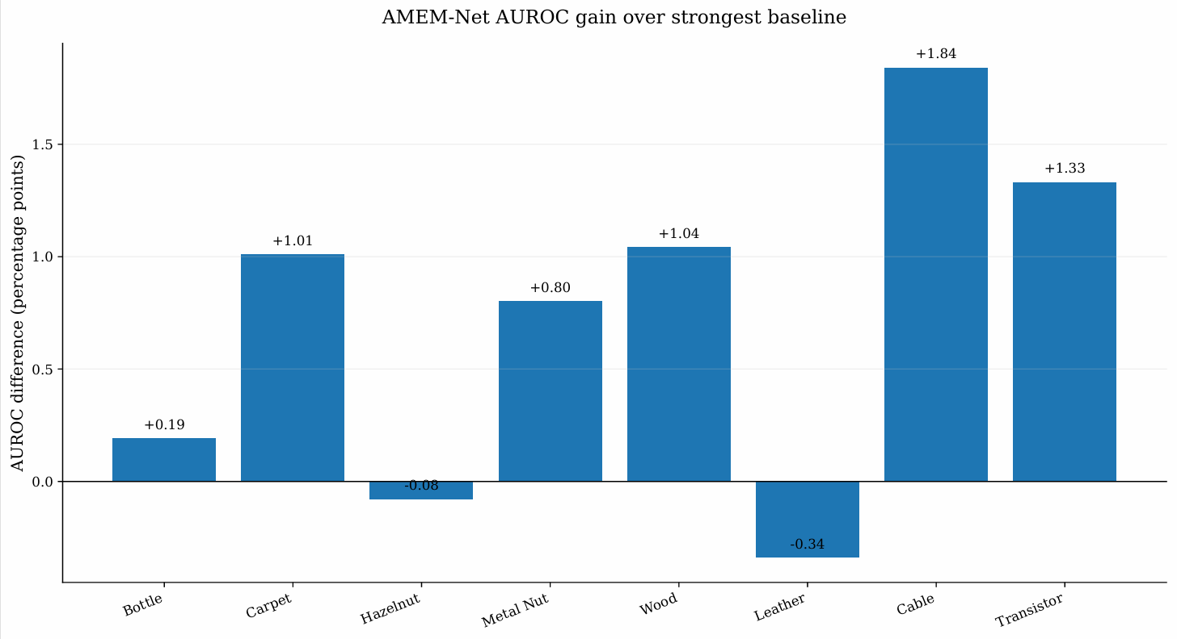
10. RESULTS

Slide 23
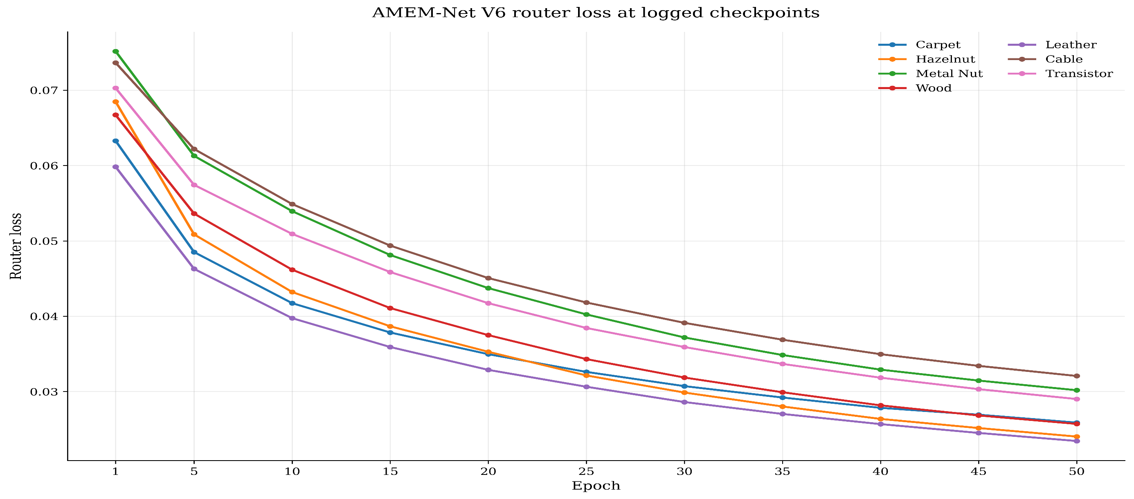
10. RESULTS

Slide 24
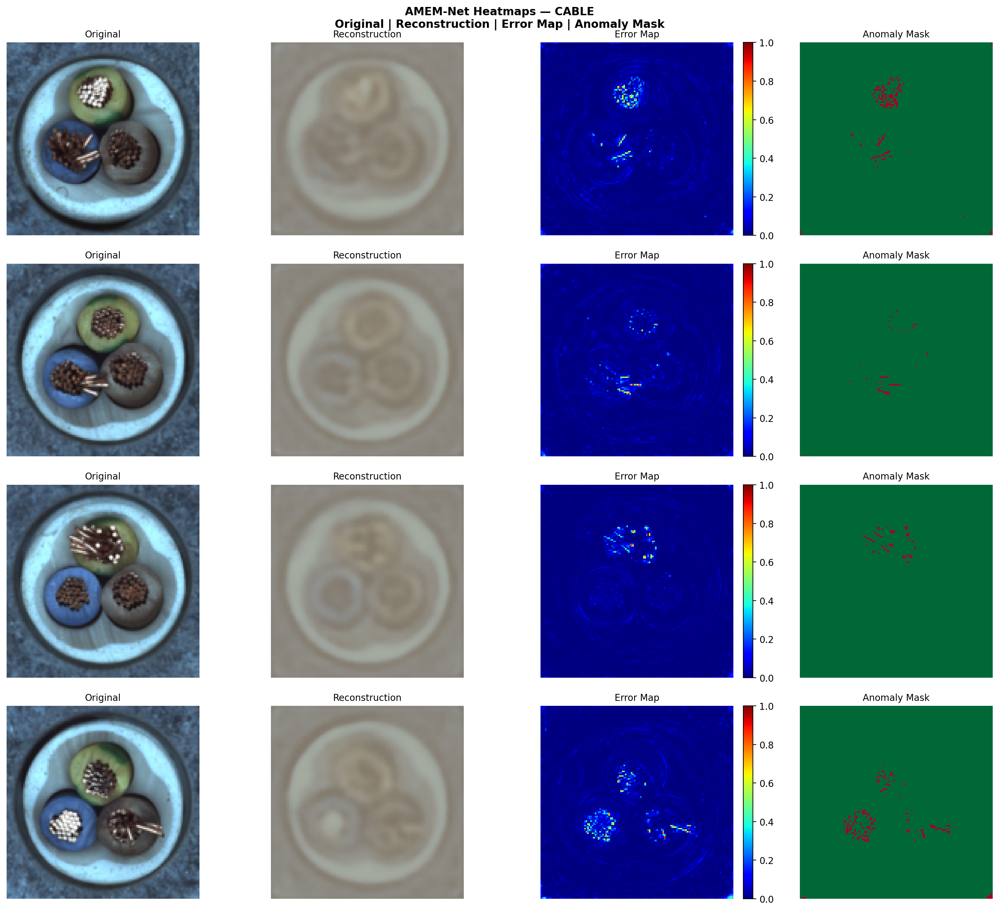
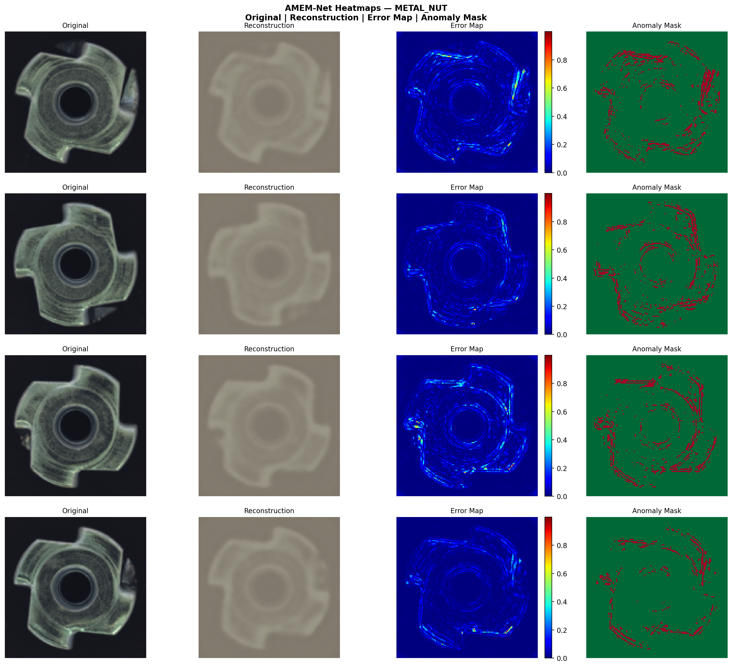
10. RESULTS

Slide 25
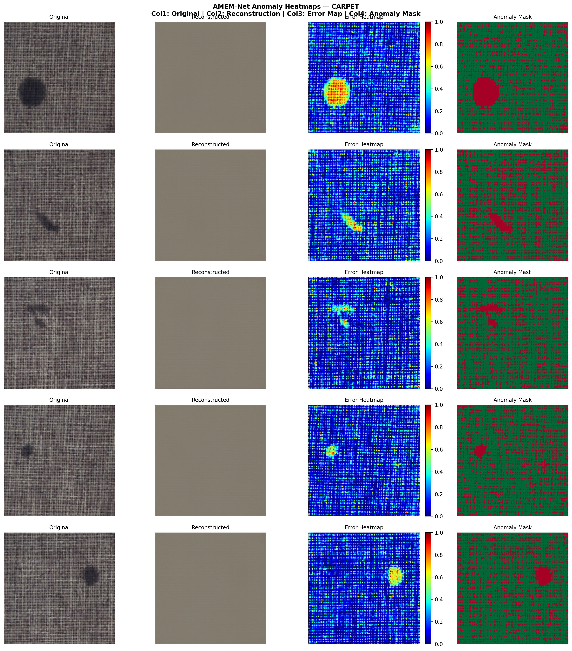
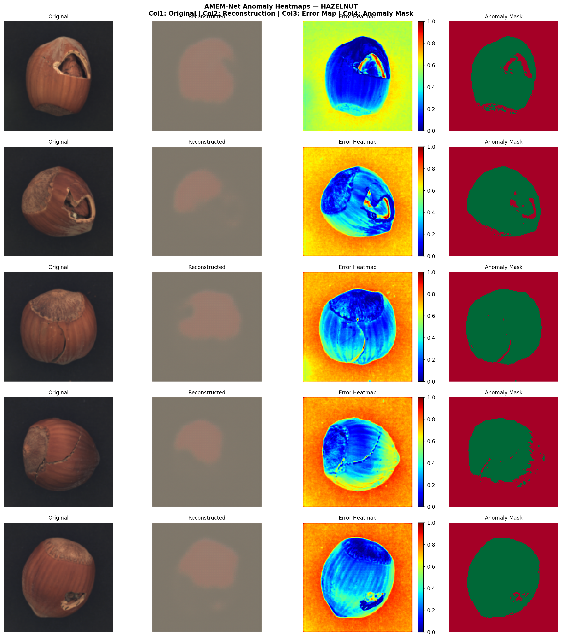
10. RESULTS

Slide 26
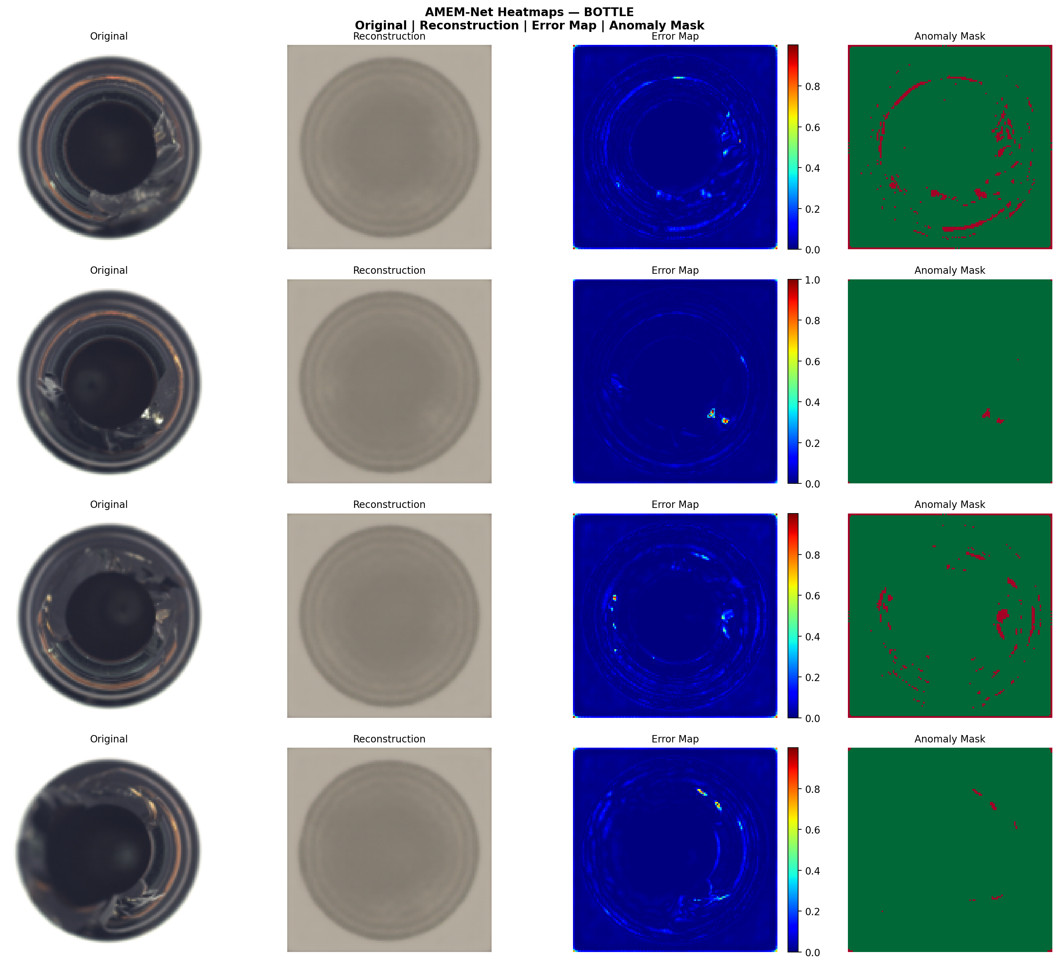
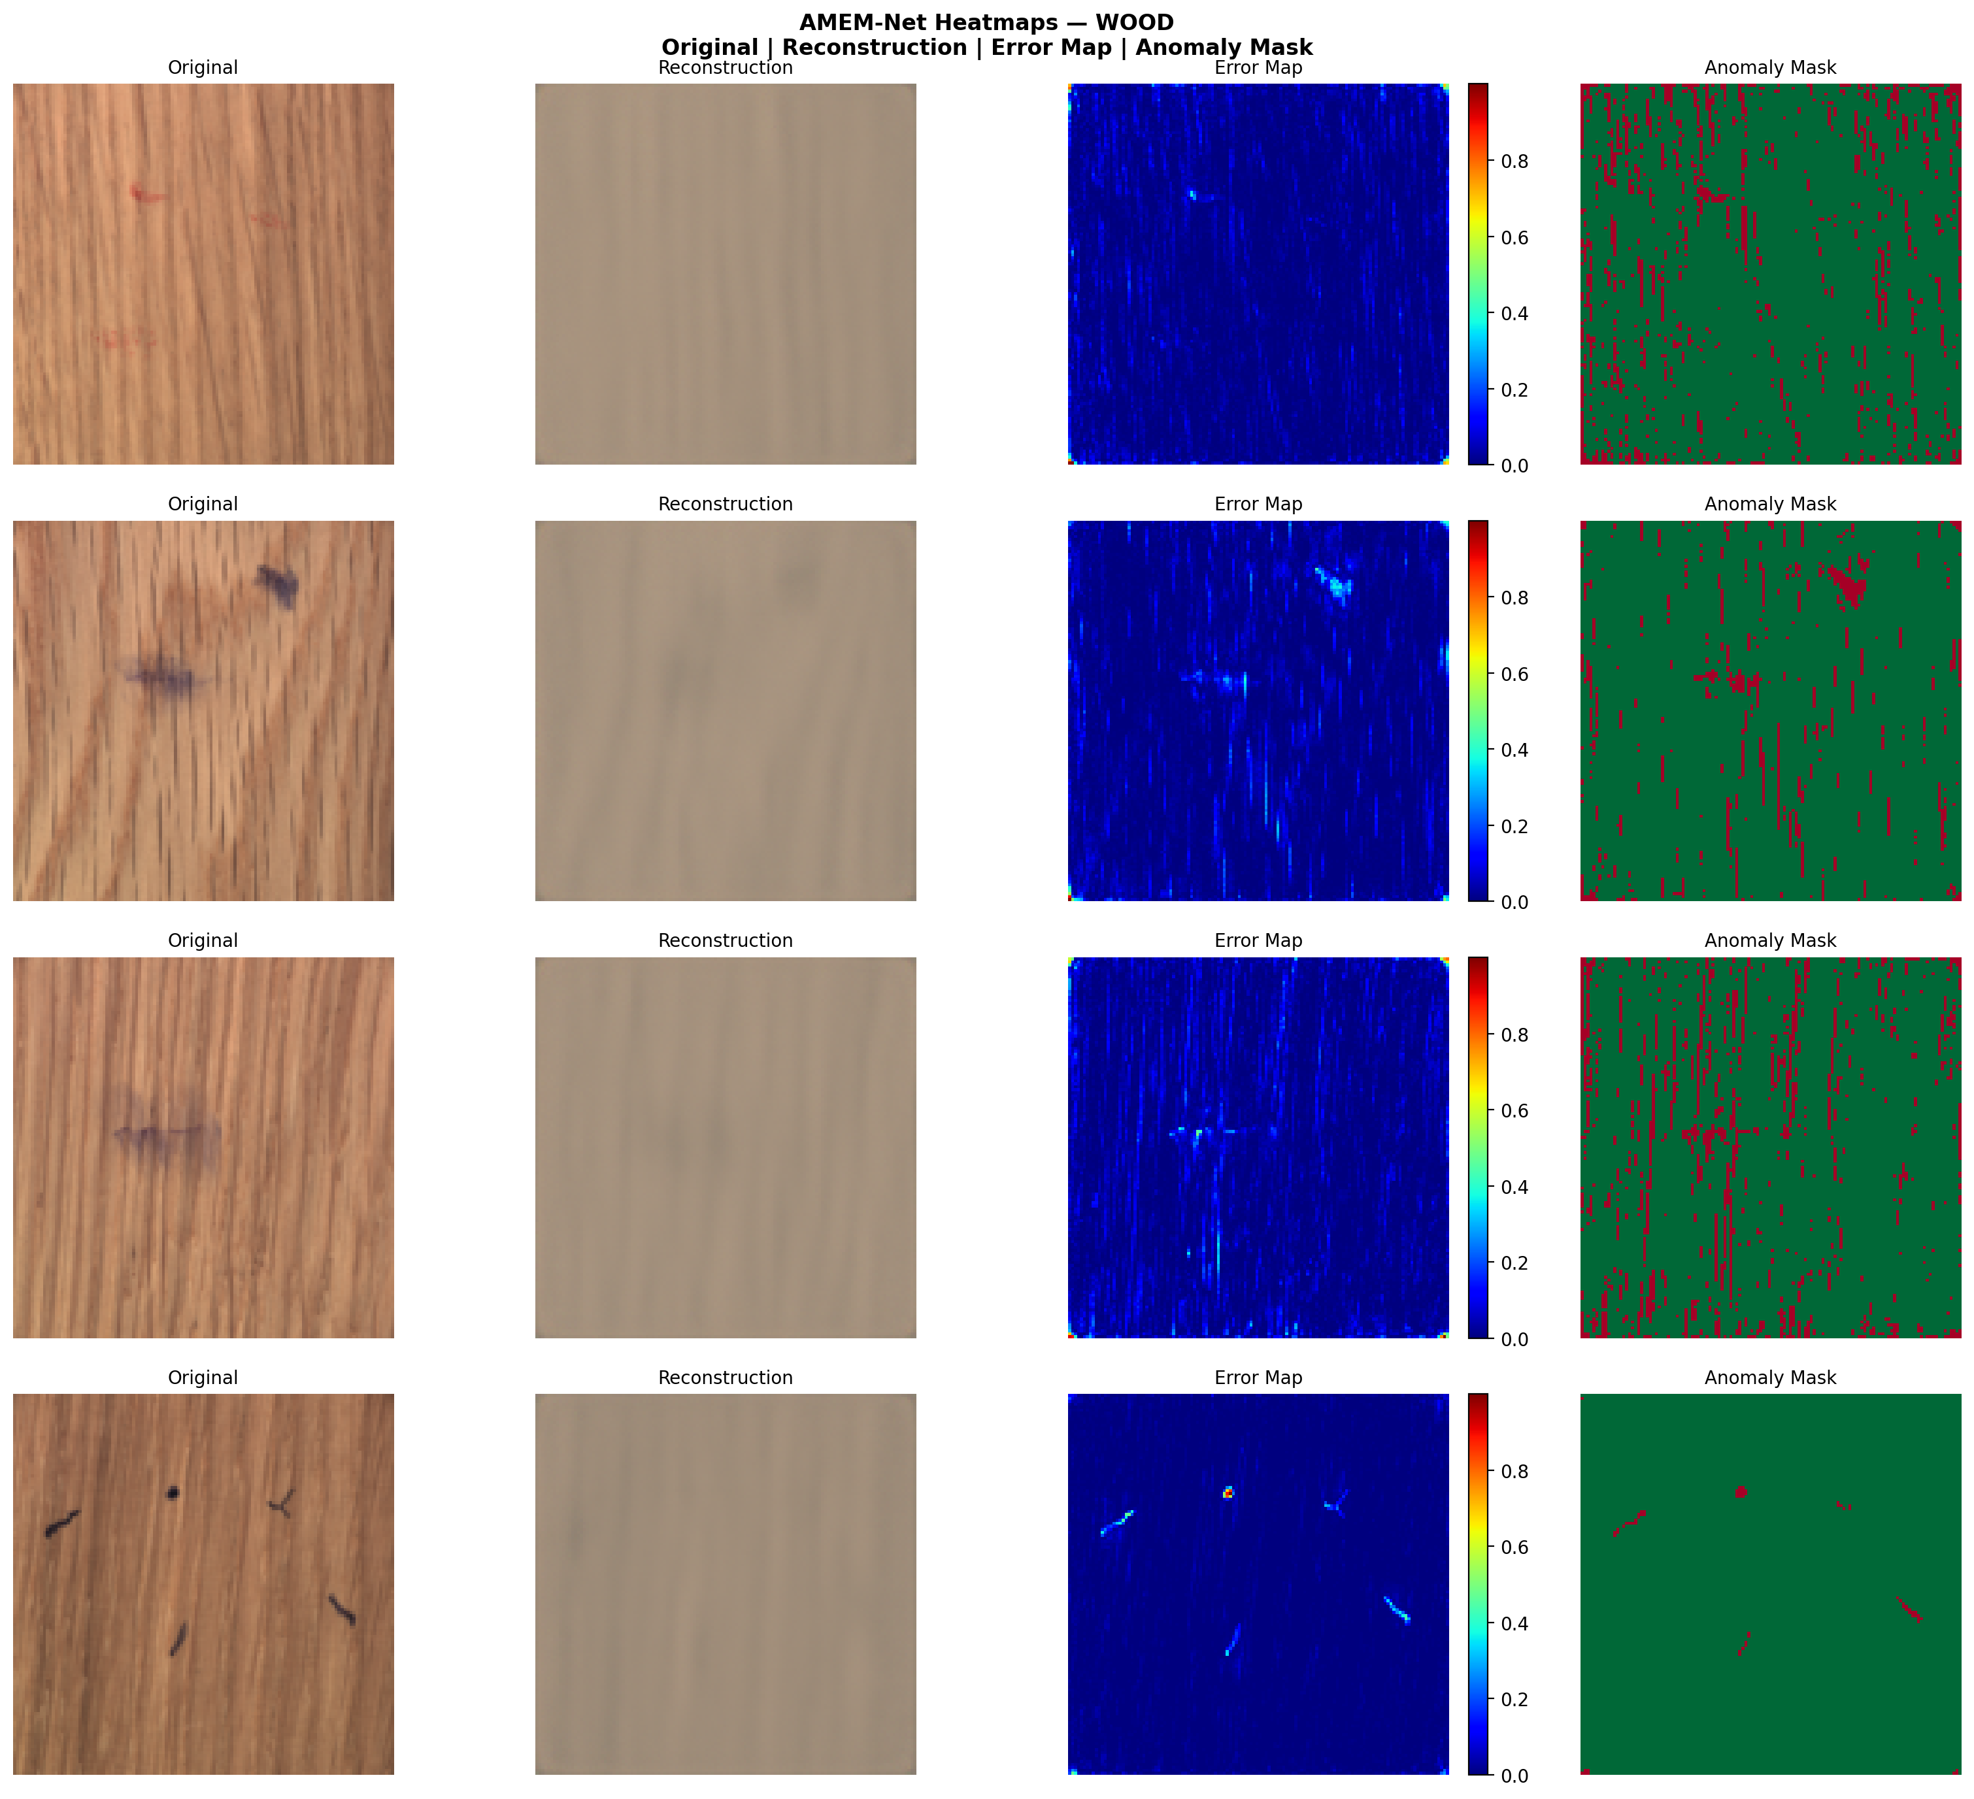
10. RESULTS

Slide 27
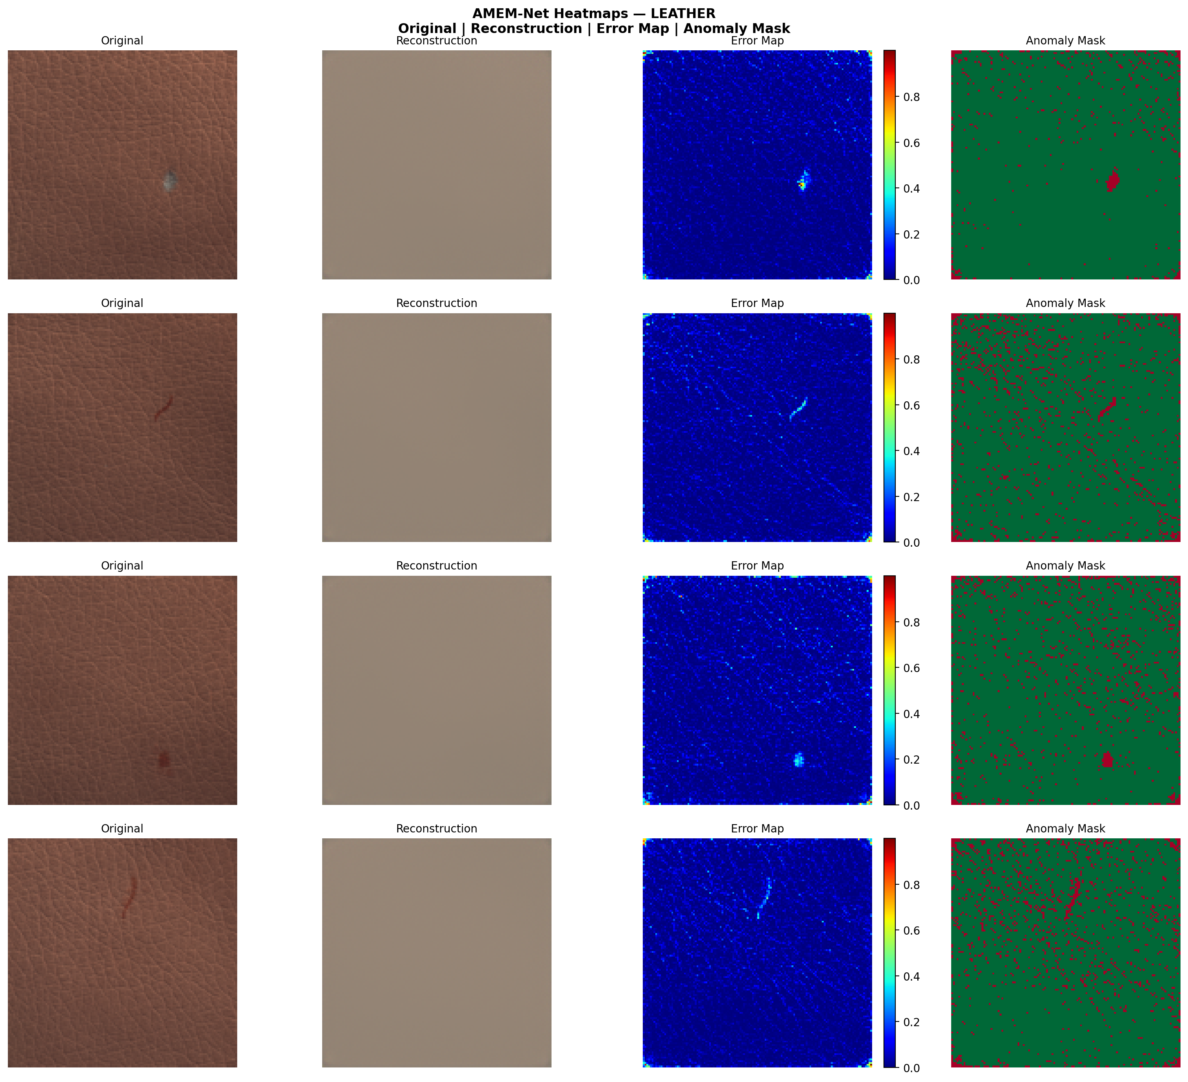
10. RESULTS

Slide 28

11. GUIDE APPROVAL MAIL SCREENSHOT

Slide 29
12. TIMELINE
S.No. | Month | Task / Activity | Milestone / Expected Outcome
1 | Month 1 | Literature review, problem identification, research gap analysis, and novelty finalization | Research gaps identified and AMEM-Net approach finalized
2 | Month 2 | MVTec AD dataset preparation, baseline implementation, and AMEM-Net development | Dataset prepared, baseline models implemented, and expert memories integrated
3 | Month 3 | Complete AMEM-Net implementation, dynamic routing, testing, performance evaluation, and result analysis | Model implementation completed and experimental results analyzed
4 | Month 4 | Final project validation, IEEE Access research paper writing and formatting, and thesis report completion | Project and thesis report completed; IEEE Access journal manuscript finalized and ready for submission

Slide 30
13. REFERENCES
[1] K. Roth, L. Pemula, J. Zepeda, B. Schölkopf, T. Brox, and P. Gehler, “Towards total recall in industrial anomaly detection,” in Proc. IEEE/CVF Conf. Comput. Vis. Pattern Recognit. (CVPR), 2022, pp. 14298–14308.
[2] Y. Liu, J. Zheng, and others, “SimpleNet: A simple network for image anomaly detection and localization,” in Proc. IEEE/CVF Conf. Comput. Vis. Pattern Recognit. (CVPR), 2023.
[3] H. Tien, J. H. Kim, and others, “Revisiting reverse distillation for anomaly detection,” in Proc. IEEE/CVF Conf. Comput. Vis. Pattern Recognit. (CVPR), 2023.
[4] X. Xing, Z. Zhang, and others, “Visual anomaly detection via partition memory bank,” 2023.
[5] Y. Wu and others, “Self-attention memory-augmented Wavelet-CNN for anomaly detection,” 2022.
[6] Z. Jiang, Y. Zhang, Y. Wang, J. Li, and X. Gao, “FR-PatchCore: An industrial anomaly detection method for improving generalization,” Sensors, vol. 24, no. 5, Art. no. 1368, 2024, doi: 10.3390/s24051368.
[7] K. Batzner, L. Heckler, and R. König, “EfficientAD: Accurate visual anomaly detection at millisecond-level latencies,” in Proc. IEEE/CVF Winter Conf. Appl. Comput. Vis. (WACV), 2024, pp. 128–138.
[8] J. Hyun, S. Kim, G. Jeon, S. H. Kim, K. Bae, and B. J. Kang, “ReConPatch: Contrastive patch representation learning for industrial anomaly detection,” in Proc. IEEE/CVF Winter Conf. Appl. Comput. Vis. (WACV), 2024, pp. 2052–2061.
[9] Q. Chen, H. Luo, C. Lv, and Z. Zhang, “A unified anomaly synthesis strategy with gradient ascent for industrial anomaly detection and localization,” in Proc. Eur. Conf. Comput. Vis. (ECCV), 2024, doi: 10.1007/978-3-031-72855-6_3.

Slide 31
13. REFERENCES
[10] J. C. Lee, T. Kim, E. Park, S. S. Woo, and J. H. Ko, “Continuous memory representation for anomaly detection,” in Proc. Eur. Conf. Comput. Vis. (ECCV), 2024.
[11] J. Li, G. Pang, and others, “MuSc: Zero-shot industrial anomaly segmentation with mutual scoring,” 2024.
[12] R. Gu and others, “AnomalyGPT: Detecting industrial anomalies using large vision-language models,” in Proc. AAAI Conf. Artif. Intell., 2024.
[13] Y. Fan and others, “Industrial anomaly detection via self-supervised feature enhancement,” 2024.
[14] Q. Zhou, G. Pang, Y. Tian, S. He, and J. Chen, “AnomalyCLIP: Object-agnostic prompt learning for zero-shot anomaly detection,” in Proc. Int. Conf. Learn. Represent. (ICLR), 2024.
[15] X. Li, Z. Zhang, X. Tan, C. Chen, Y. Qu, Y. Xie, and L. Ma, “PromptAD: Learning prompts with only normal samples for few-shot anomaly detection,” in Proc. IEEE/CVF Conf. Comput. Vis. Pattern Recognit. (CVPR), 2024, pp. 16838–16848.
[16] Y. Cao, J. Zhang, L. Frittoli, Y. Cheng, W. Shen, and G. Boracchi, “AdaCLIP: Adapting CLIP with hybrid learnable prompts for zero-shot anomaly detection,” in Proc. Eur. Conf. Comput. Vis. (ECCV), 2024.
[17] H. He and others, “MambaAD: Exploring state space models for multi-class unsupervised anomaly detection,” in Adv. Neural Inf. Process. Syst. (NeurIPS), vol. 37, 2024.

Slide 32
13. REFERENCES
[18] B. Rolih, D. Ameln, A. Vaidya, and S. Akçay, “Divide and conquer: High-resolution industrial anomaly detection via memory efficient tiled ensemble,” in Proc. IEEE/CVF Conf. Comput. Vis. Pattern Recognit. Workshops (CVPRW), 2024, pp. 3866–3875.
[19] M. Koshil, T. Wegener, D. Mentrup, S. Frintrop, and C. Wilms, “AnomalousPatchCore: Exploring the use of anomalous samples in industrial anomaly detection,” 2024.
[20] G. Gui, B.-B. Gao, J. Liu, C. Wang, and Y. Wu, “Few-shot anomaly-driven generation for anomaly classification and segmentation,” in Proc. Eur. Conf. Comput. Vis. (ECCV), 2024.
[21] J. Guo, S. Lu, W. Zhang, F. Chen, H. Li, and H. Liao, “Dinomaly: The less is more philosophy in multi-class unsupervised anomaly detection,” in Proc. IEEE/CVF Conf. Comput. Vis. Pattern Recognit. (CVPR), 2025, pp. 20405–20415.
[22] H. Sun, Y. Cao, H. Dong, and O. Fink, “Unseen visual anomaly generation,” in Proc. IEEE/CVF Conf. Comput. Vis. Pattern Recognit. (CVPR), 2025, pp. 25508–25517.
[23] J. He, M. Cao, S. Peng, and Q. Xie, “RareCLIP: Rarity-aware online zero-shot industrial anomaly detection,” in Proc. IEEE/CVF Int. Conf. Comput. Vis. (ICCV), 2025, pp. 24478–24487.
[24] H. Ma, G. Yang, D. Zhao, Y. Ji, and W. Zuo, “ReMP-AD: Retrieval-enhanced multi-modal prompt fusion for few-shot industrial visual anomaly detection,” in Proc. IEEE/CVF Int. Conf. Comput. Vis. (ICCV), 2025, pp. 20425–20434.

Slide 33
13. REFERENCES
[25] W. Zhu, L. Wang, Z. Zhou, C. Wang, Y. Pan, R. Zhang, Z. Chen, L. Cheng, B.-B. Gao, J. Zhang, Z. Gan, Y. Wang, Y. Chen, S. Qian, M. Chi, B. Peng, and L. Ma, “Real-IAD D3: A real-world 2D/pseudo-3D/3D dataset for industrial anomaly detection,” in Proc. IEEE/CVF Conf. Comput. Vis. Pattern Recognit. (CVPR), 2025, pp. 15214–15223, doi: 10.1109/CVPR52734.2025.01417.
[26] S. Mokhtar, A. Mousakhan, S. Galesso, J. Tayyub, and T. Brox, “Detect, classify, act: Categorizing industrial anomalies with multi-modal large language models,” in Proc. IEEE/CVF Conf. Comput. Vis. Pattern Recognit. Workshops (CVPRW), 2025, pp. 4097–4106.
[27] C. Tao, X. Cao, and J. Du, “G2SF: Geometry-guided score fusion for multimodal industrial anomaly detection,” in Proc. IEEE/CVF Int. Conf. Comput. Vis. (ICCV), 2025, pp. 20551–20560.
[28] “A multi-expert framework for enhancing multimodal large language models in industrial anomaly detection,” 2025.
[29] “Memory-enhanced contrastive learning for industrial anomaly detection,” 2025.
[30] “Unsupervised anomaly detection and localization with multi-scale feature reconstruction,” 2025.

Slide 34
Thank You

